Slide 1
Reading Test Answering by NLI
Group 5
109022136 陳致寧
109022127 徐偉晉

Slide 2
Target
能夠回答大部分題型的閱讀測驗(選擇題)
Method：Natural Language Inference(NLI)
Data：歷年學測、指考與模擬考試題

Slide 3
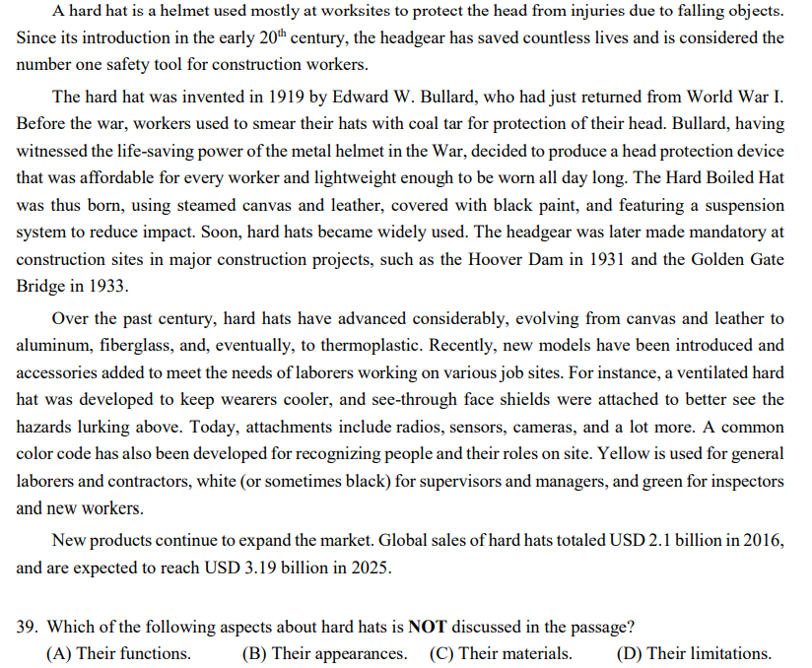
Dataset
大考中心歷屆英文試題閱讀測驗
Training(共約500題):
94~109學年度指考試題
94~109學年度學測試題
Validation(共32題):
110學年度學測、指考試題

Slide 4
Preprocessing
從.pdf、.docx存取並分類出文章與題目及答案(PyPDF2, docx)
Regular expression is useful!!! 去除中文標籤、換行符號與不必要的空格等等
去除文章題組的hierarchy，使每個問題都有對應到的content(文章內容)與question(題幹)
也記錄年度與題號等資訊，最後存成.json檔

Slide 5
Example:
"Year": "題目/110學測",
"reading_question": [
{
"ID": 41,
"answer": "B",
"question": "What is the purpose of this passage?"
"choice": {
"A": "To argue for the benefits of nopales.",
"B": "To introduce a new source of energy.",
"C": "To predict the future agriculture policy of Mexico.",
"D": "To change people’s ideas about energy consumption."
},
"content": "The prickly pear cactus is such a powerful symbol in Mexico that it occupies a prime spot on Mexico’s national flag. The plant was considered sacred by the ancient Aztecs, and modern-day Mexicans eat it, drink...“
{"ID": 42, ...}
}

Slide 6
Preprocessing
Load .json => pandas, 並將label(A, B, C, D)做One-hot-encoding
Noticed: One-hot-encoding的結果是為了方便對每個選項標出True/False,
並不是直接用ABCD分類做Classification

Slide 7
Modeling
Tokenize文章內容(content)、題幹與選項(statement)
Sentence-BERT encoder embedding(model: multi-qa-mpnet-base-dot-v1)
Try: 將各個statement、content的embedding vector內積後得到答案(Similarity Prediction)
Neural Network
每題根據四個statement的logistic value高低判斷答案(Model Prediction)
Optional: compare Similarity Prediction, Model Prediction

Slide 8
Structure
Sentence preprocessing
Tokenizer
BERT-transformer
embedding
Model
prediction
Final answer
Similarities
Phrase-Bert embedding

Slide 9
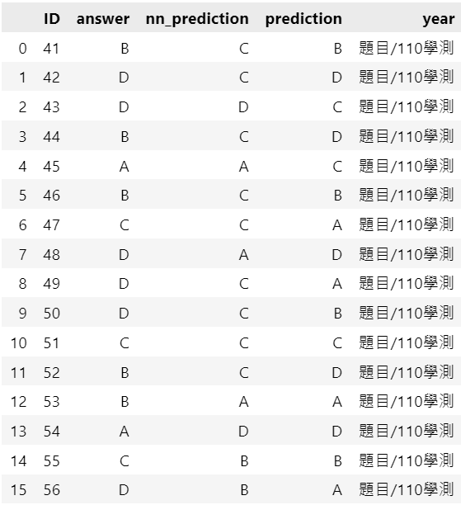
Result (Model Prediction)
110學測：5/16; 5/16(Model/Similarity)
110指考：6/16; 5/16(Model/Similarity)

Slide 10
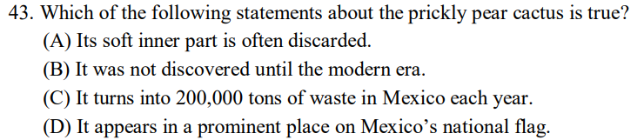
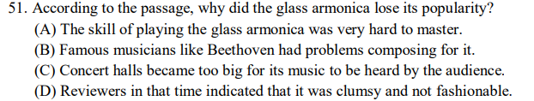
較能正確回答的問題類型: why a statement is true

Slide 11
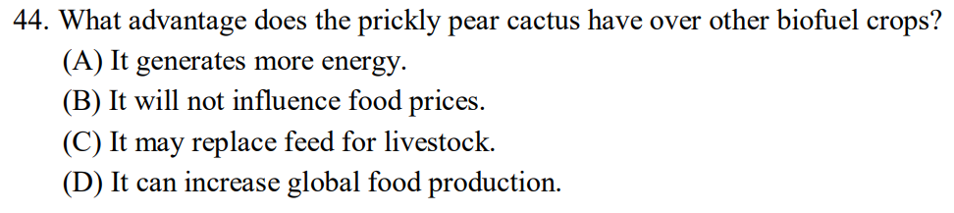
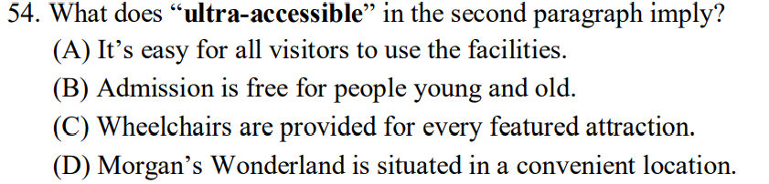
回答錯誤的問題類型: 問題與”整句話的意義”較無直接相關

Slide 12
Discussion
將文章tokenize的方式
e.g. 整個文章產生一個vector or 每句產生vector後mean pooling出一個vector
or 切成N等分
Size of Dataset(Is ~2000 statement enough?)
We found that the classification of question(or statement) is hard and crucial.

Slide 13
Reference
Huggingface Documentation
https://www.sbert.net/(SentenceTransformers Documentation)
https://arxiv.org/abs/1908.10084(Sentence-BERT: Sentence Embeddings using Siamese BERT-Networks)

Slide 14
Thank You!!!
HAPPY NEW YEAR!!!

Slide 15
Q&A Time

